Slide 1
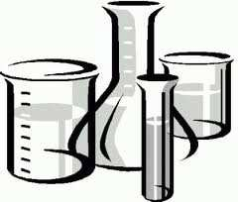
Analytical Chemistry lec.8
Prof. . Dr./ Nadia Y. Ahmed
Emeritus Prof. of Biochemistry, Fac. of Agric. Benha Univ.
Dr/ Nesreen S. Salim

Slide 2
Back Titration
Basically, you use a back titration when you need to determine the strength or concentration of an analyte and you have a known molar concentration of excess reactant. It's typically applied in acid-base titrations when the acid or (more commonly) base is an insoluble salt (e.g., calcium carbonate),

Slide 3
when direct titration endpoint would be hard to discern (e.g., weak acid and weak base titration), or when the reaction occurs very slowly. Back titrations are applied, more generally, when the endpoint is easier to see than with a normal titration, which applies to some precipitation reactions.

Slide 4
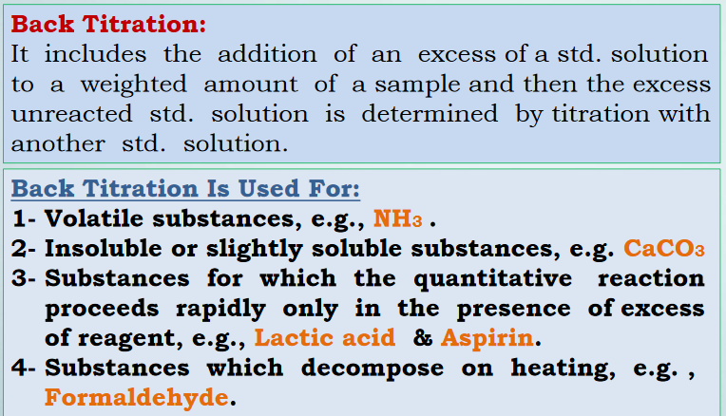

Slide 5
Determine of ammonium salt purity
Weight accurately the sample(1 g of ammonium sulfate) and place in volumetric flask
then use2 .25 ml of NaOH in a pipette for the titrations and boiling.
After boiling, titrate the excess of NaOH by HCl solution known concentration .
So
Equivalent number of ammonium sulfate = Equivalent number of NaOH - Equivalent number of HCl

Slide 6
For example :
A non-pure sample of ammonium sulfate weighed 0.7 grams, was treated with a volume of 100 ml of 0.15 N NaOH, and after heating it was needed to 50 ml of 0.1 N of acetic acid to neutralize the solution. Calculate the purity of the sample and the weight of the ammonia in the sample.
Solution :
Eq. n. of (NH₄)₂ SO₄ = Eq n. of NaOH - Eq. n. of CH3COOH
Mass/ E.W. = (V*C)- (V*C)
Mass/ 66 = ( (100/1000)*0.15) – ((50/1000)*0.1)
So
Mass = 0.66 gram
the purity = ( pure mass / total mass) × 100
= (0.66/0.7 ) × 100 = 94.28 %

Slide 7
weight of the ammonia in the sample:
1 mol of ammonium sulfate having 2 mole of ammonia according to the following equation:
(NH₄)₂ SO_{4 →} 2 NH₄
Weight =( M.W. of 2 NH4 × pure mass) / M.W of (NH4)2 SO4
= ( 40 × 0.66 ) / 132 = 0.2 g

Slide 8
And NOW TRY THIS:
A mixture containing 0.1 mol of both ammonium chloride and ammonium phosphate. Calculate the weight of sodium hydroxide needed to remove ammonia from the mixture. And what is the weight of the nitrogen produced from the mixture?

Slide 9
some examples
1- 50 ml of silver nitrate solution 0.21 N was added to 0.5 g SrCl2. After separation of the ppt with AgCl . 25.5 ml of KCNS 0.28 N was needed to equilibrium. What is the ratio of SrCl2 in the sample.
Solution:
E.N. of AgNO3 = E.N. of SrCl2 + E.N. of KCNS
V × N = (MASS /E.W) + V× N
(50/1000) × 0.21 = (MASS/ (78.81÷2)) + (25.5/1000 ) × 0.28
MASS = 0.265 g
% of SrCl2 =( 0.265/0.5 ) × 100 = 53 %.

Slide 10
2- An indigestion was curshed up a tablet and an excess hydrochloric acid (25.0 cm3 of 1.00 mol dm-3). The resulting solution was titrated against 0.500 mol dm-3 NaOH requiring 25.8 cm3 of the NaOH. Calculate the mass of calcium carbonate in the tablet.
solution:
Mole of NaOH =molar concentratin / volum per liter = (0.500 × 25.8)/1000 = 0.0129
HCl + NaOH → NaCl +H2O
So
Moles of HCl = 0.0129
Mole of HCl intially = (25.0 × 1.00)/1000 =0.025
Mole of HCl used = 0.025 - 0.0129 = 0.0121
CaCO3 + 2HCl → CaCl2 + CO2 + H2O
SO :mols of CaCO3 = 0.0121 / 2 = 6.05 × 10-3
Mass of CaCO3 = mols / molecular weight = 6.05 × 10-3 / 100 =0.606 gram

Slide 11
3- A fertiiliser contains ammonium sulphate and potassium sulphate. A sample of 1.455 g og the fertiliser was warmed with 25.0 cm3 0.200 mol dm-3 sodium hydroxide solution giving off ammonia gas. The remaining NaOH that was not used required 28.7 cm3 of 0.100 mol dm-3 hydrochloric acid for neutralisation. Calculate the percentage by mass of ammonium sulphate in the sample.
Solution :
Moles of HCl =( 28.7 × 0.100 )/1000 = 2.78 × 10-3
HCl + NaOH → NaCl +H2O
So:Moles of NaOH = 2.78 × 10-3
Moles of NaOH =( 25.0 × 0.200 )/1000 =0.005
Moles of NaOH = 0.005 - 2.78 × 10-3 = 0.000213
NH₄⁺ + OH⁻ → NH₃ + H₂O
Moles of NH₄⁺ = moles of OH = 0.000213
Moles of( NH₄ )2 SO4 = 1.065 × 10-3
Mass = 0.141 g
Percentage = ( 0.141 / 1.455) × 100 = 9.69 %

Slide 12
4- 150.0 ml of 0.2105 M nitric acid was added excess to 1.3415 g calcium carbonate .The excess acid was back titrated with 0.1055 M sodium hydroxid. It required 75.5 ml of the base to reach the endpoint . Calculate the percentage (w/w) of calsium carbonate in the sample.
A) Extraction information :
HNO3 V= 150.0 ml ,M= 0.2105 M
CaCO3 mass = 1.3145 g
NaOH V = 75.5 ml , M= 0.1055 M
B) write the balanced equation :
2HNO₃ + CaCO₃ → Ca(NO₃)₂ + CO₂ + H₂O (1)
HNO₃ + NaOH → NaNO₃ + H₂O (2)
2 mole of HNO₃ react with 1 mole of CaCO₃
1 mole of HNO₃ react with 1 mole of NaOH
C)- Calculate no. of mole
Intial amount of HNO_{3 :}
No. of mole of acid = 0.2105 × 150 = 31.575 mole acid.
excess acid
No. of mole of excess acid = 0.1055 × 75.5 = 7.965 mmole acid

Slide 13
mole of acid reacted with CaCO3 = (31.575 – 7.965) = 23.61 mole acid
_{D) mole ratio}
_{2 mole of} HNO_{3 react with 1 mole of CaCO3}
_{Thus , 23.61 mole of} HNO3react with ½ (23.61) mole of CaCO3
mole of CaCO3 = ½ × mole acid = ½ × 32.61 = 11.805 mole CaCO3
_{E) Find mass}
_{Gram CaCO3} = mole × molar mass = 11.805 × 10-3 × 100 = 1.1805 g
F) Find percentage
% CaCO3 = weight of sample _{× 100}
= (1.1805/1.3415) × 100 = 87.99 %

Slide 14
NOW TRY THIS
A 0.500 g sample containing Na2CO3 is analyzed by adding 50.0 ml of 0.100 M HCl , a slight excess , boiling to remove CO2 , and then back-titration the excess acid with 0.100 M NaOH . I f 5.6 ml NaOH is required for the back titration , what is the percent Na2CO3 in the sample ?
Molar mass for Na2CO3 = 106
Answer (47.1%)

